Slide 1



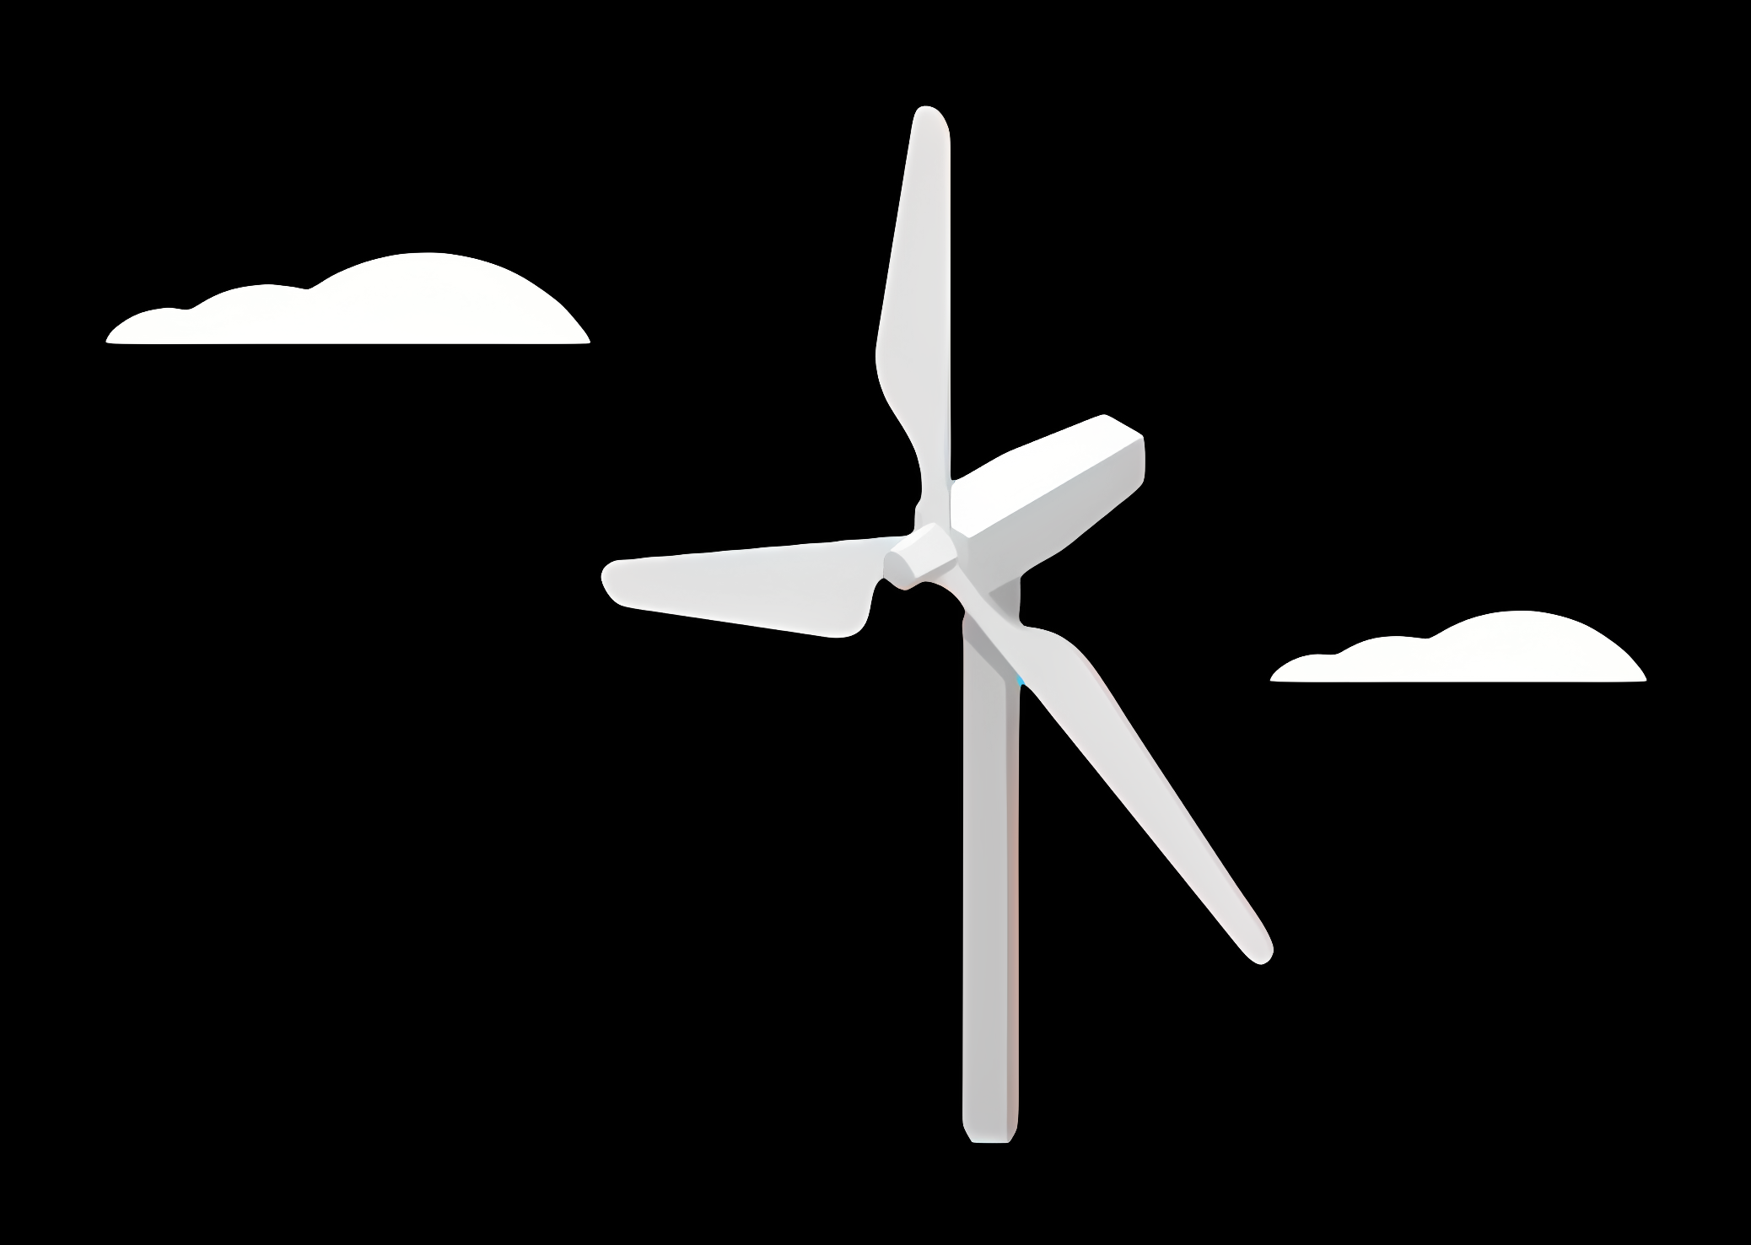
Tower Structure
Agenda
Data base for the Tower Structure
Market availability &Existing wind Turbine
SWOT Analysis
Tower Selection
relevant standards and guidelines
References
Supervisor: Prof. Faber
Team Members ( Ibrahim Mostafa, Kirollos Ghaly, Mohammed El demerdash)

Slide 2
Data base for the Tower Structure
Turbine Size:
Power: 5 MW
Hub Height: 100 m
Environmental Data:
Wind Class II
Soil conditions: Sand or Rock
Location: Syria

Slide 3
Market availability & Existing wind Turbine
Tubular steel tower
Available Hub high
100 – 140 m
No. available suppliers
11 (Turkey, China, Europe)
Suitability for Syria
Most common choice. Good quality, fast delivery if port access & wide roads are available
Concrete Cast-in-situ
Available Hub high
100 – 120 m (custom)
No. available suppliers
Local contractor + slipform system
Suitability for Syria
Best for remote or mountainous sites. No need to transport large sections, only bulk materials.
Concrete precast tower
Available Hub high
100 – 120 m (custom)
No. available suppliers
Limited global suppliers
Suitability for Syria
Heavy transport required, may be challenging and costly to deliver to Syrian sites.
Lattice Steel tower
Available Hub high
Up to ~100 m
No. available suppliers
Few suppliers worldwide
Suitability for Syria
Lightweight and easy to transport but needs more maintenance
Timber tower
Available Hub high
Up to ~100 m No. available suppliers
Very few suppliers worldwide (limited market technology, but growing market) Suitability for Syria
Requires careful protection against moisture, insects, and fire

Slide 4
SWOT Analysis
Structure types
Tubular steel
Concrete Cast-in-situ
Concrete precast
Lattice Steel tower
Timber tower

Slide 5
SWOT Analysis for Tubular tower
Proven Technology: Widely used globally for 100 m hub height turbines, high reliability.
High Structural Strength: Good performance for large rotor diameters and high wind loads Long Lifetime: Low maintenance needs compared to lattice or hybrid towers
Regional Suppliers: Proximity to Turkey and Middle East suppliers reduces manufacturing lead time
Strengths
Weaknesses
High Initial Cost: Steel price volatility can significantly affect CAPEX . Transport Challenges: Oversized sections (up to 30+ m length, 4–5 m diameter) require wide roads and heavy-duty trucks – can be difficult in remote sites.
Dependency on Imports: No local tower manufacturing in Syria → exposure to currency fluctuations and import regulations.
SWOT
Renewable Energy Expansion: Syria has strong wind potential in coastal and mountain regions, creating opportunities for new projects. Local Assembly Potential: Possibility to develop local welding/painting facilities to reduce import costs in the future.
Government & International Support: Potential funding from international organizations for renewable energy reconstruction projects.
Opportunities
Threats
Logistics Risks: Border closures, port access issues, or road infrastructure damage can delay tower delivery.
Competing Tower Technologies: Cast-in-situ concrete towers may become cheaper and easier to implement locally.
Steel Price Fluctuations: Global market volatility can increase project costs unexpectedly.

Slide 6
SWOT Analysis for Concrete Cast-in-Situ Tower
Local Material Availability: Cement, aggregates, and rebar can be sourced locally, reducing import dependency.
No Need for Oversized Transport: Tower is built on-site → avoids challenges of moving large sections on narrow or damaged roads.
Durability & Long Life: Good resistance to corrosion and low maintenance needs in harsh climates Flexibility in Height: Can be customized easily for required hub height without special factory tooling
Strengths
Weaknesses
Longer Construction Time: Slipform casting takes several weeks of continuous work.
Need for Skilled Labor & Equipment: Requires experienced teams and specialized formwork systems.
Quality Control Risk: Poor curing or bad concrete mix can affect tower integrity if site supervision is weak.
Higher Upfront Mobilization: Need to mobilize formwork, cranes, batching plants to remote site.
SWOT
Job Creation: Uses local workforce, boosting local economy Lower Long-Term Costs: Potentially cheaper than imported steel towers, especially with high global steel prices.
Support for Local Industry: Encourages development of local concrete construction expertise
International Funding Potential: Reconstruction & renewable energy programs may support local material solutions.
Opportunities
Threats
Security Risks: Interruptions during multi-week construction period can delay work Weather Dependence: Continuous slipform process sensitive to rain, temperature changes Competition from Steel Towers: If steel prices drop, steel towers may become cheaper and faster to install.
Supply Chain Risks: Shortages of cement, aggregates, or fuel can delay casting process

Slide 7
SWOT Analysis for Concrete precast Tower
High Quality Control: Precast segments are produced in factory under controlled conditions → consistent strength and durability.
Fast On-Site Assembly: Once segments are delivered, tower can be assembled relatively quickly Durability: Excellent resistance to corrosion → very low maintenance over lifetime Long Service Life: Comparable or better than steel towers in harsh environmental conditions
Strengths
Weaknesses
Heavy Transport Required: Segments are very heavy and bulky → requires wide roads, special trailers, and strong cranes.
High Mobilization Costs: If no local precast factory, segments must be imported or factory built near site.
Limited Local Capacity: Syria may not have large-scale precast facilities for tall towers.
Logistics Complexity: Each segment must arrive on time for erection schedule, risk of delays
SWOT
Local Industry Development: Potential to set up precast plant locally for wind projects → long-term benefit. Lower Long-Term O&M Cost: Very low corrosion risk → reduces maintenance budget.
Good for Coastal/Moist Areas: Concrete performance is better in saline environments compared to unprotected steel.
International Partnership: Opportunity to partner with experienced precast suppliers from Turkey or Europe.
Supply Chain Vulnerability: Cement or reinforcement shortages can delay production High Transportation Cost: Especially critical in mountainous areas or where infrastructure is damaged Political / Border Delays: Customs or port delays can stall delivery of large segments Competition from Cast-in-Situ: Cast-in-situ may be cheaper and avoid transport problems
Opportunities
Threats

Slide 8
SWOT Analysis for Lattice steel Tower
Lightweight Structure: Uses less steel compared to tubular tower → lower material cost. Easy transport: Sections are small and can be transported on regular trucks, ideal for remote/mountainous areas with narrow roads. Lower Foundation Loads: Reduced overall weight means smaller and cheaper foundations. Proven for Small/Medium Turbines: Used globally where cost optimization is critical.
Strengths
Weaknesses
High Maintenance: Many bolted connections → regular inspection and tightening needed. Noise Amplification: Can slightly increase aerodynamic noise due to lattice members. Limited for Very Large Turbines: Not ideal for >3 MW turbines or very large rotor diameters.
SWOT
Local Fabrication: Can be produced in local steel workshops with basic welding/bolting capability → supports local industry.
Low Transport Cost: Advantage in areas with weak infrastructure (roads/bridges). Lower CAPEX: Can be cheaper than tubular tower if steel prices are high. Rapid Deployment: Fabrication and erection can be done in parallel with site prep.
Community Resistance: Visual and noise concerns may reduce public acceptance, especially near populated areas. Corrosion Risk: Open members exposed to weather need good galvanization → risk of corrosion if maintenance neglected.
Competition from Tubular Towers: OEMs may prefer tubular towers for large turbines. Political & Security Risks: More frequent maintenance visits might be challenging in unstable regions.
Opportunities
Threats

Slide 9
SWOT Analysis for Timber Tower
Sustainable Material: Wood is renewable → much lower CO₂ footprint compared to steel or concrete. Lightweight: Reduces foundation loads and simplifies transport. Prefabrication: Segments can be produced off-site and assembled quickly → reduces on-site construction time.
Good Fatigue Performance: Laminated wood can handle cyclic loading well if designed properly.
Strengths
Weaknesses
Very Limited Local Experience: No established timber tower manufacturing in Syria. Moisture Protection Required: Needs special surface treatment to resist humidity, rain, and UV. Fire Resistance Concerns: Requires careful fire protection design and certification. High Initial Investment: Need for specialized production lines and technology transfer.
SWOT
Sustainability Goals: Can attract international funding or climate-finance programs (low-carbon construction).
Local Wood Industry Development: Potential to use locally sourced timber (if quality and quantity allow) → job creation.
Innovative Image: Positions the project as a pilot for green construction technology in the region. Lower Long-Term CO₂ Cost: Future carbon pricing schemes may favor timber over steel.
Climate Suitability: Harsh weather (heat, sand, moisture) may degrade wood faster without proper coating. Limited Suppliers: Only a few global companies produce timber towers → supply risk. Higher Certification & Insurance Requirements: Investors may demand extra testing/documentation Competing Mature Technologies: Steel and concrete towers are cheaper and well-proven for 100 m, reducing commercial interest.
Opportunities
Threats

Slide 10
Tower Selection
Recommendation: The best tower option for a hub height of around 100 m in Syria is tubular steel.
Why: Proven Technology: Most common globally for onshore turbines, very well understood by Original Equipment Manufacturers (Vestas, Siemens Gamesa, etc.).
Predictable Supply Chain: Suppliers are available regionally (Turkey, Middle East) → short lead times and easier logistics compared to importing precast segments.
Faster Installation: Prefabricated sections allow relatively quick erection on-site (2–4 weeks).
Maintenance & Reliability: Lower inspection/maintenance effort compared to lattice towers (no hundreds of bolted joints).
Standardization: Matches industry norms, easier to certify under IEC 61400 and DNV guidelines.

Slide 11
relevant standards and guidelines
Wind Turbines:
IEC 61400-1: Design Requirements – Defines overall structural and safety requirements.
IEC 61400-6: Tower and Foundation Design Requirements – Key standard for tower load cases, structural integrity, and fatigue.
Steel Towers:
EN 1993 (Eurocode 3): Design of Steel Structures.
Concrete Towers
EN 1992 (Eurocode 2): Design of Concrete Structures.
Timber Towers
EN 1995 (Eurocode 5): Design of Timber Structures.

Slide 12
References
Siemens Gamesa – Onshore Wind.
CS Wind – Global Tower Manufacturer.
GRI Renewable Industries – Tower Solutions.
Modvion – Timber Towers.
Lowa state university.
Wikepedia.

